Slide 1
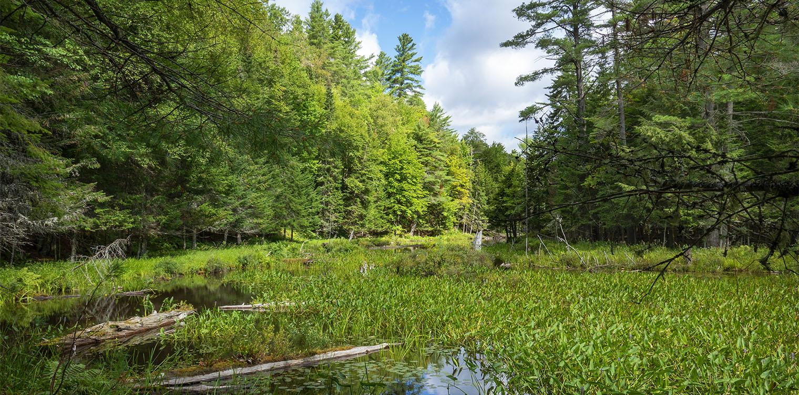

SCHOOL PROGRAM CLASSROOM EXTENSION
START
CARNIVOROUS
PLANTS
TUTORIAL
TEACHER’S GUIDE

Slide 2
How to play:
It is recommended to play on desktop devices or smartboards with a mouse
Do NOT use arrow keys throughout the game!
Click on the arrow in the top left corner to return to the bog at any time
Click on the bog image to return to the bog when finished with each section
Click here to return to
The Main Menu!

Slide 3
TEACHER’S GUIDE
Welcome to the teachers guide to the Carnivorous Plants Extension Activity!
Here you can find helpful resources to make this
a fun experience for you and your students.
Additional Resources
Tips & Tricks
Prompts & Projects
Click here to return to
The Main Menu!

Slide 4

Additional Resources
Below are a several carnivorous plant related books, videos, and documentaries to spark your students interest!
Videos and Documentaries
Books
Book Title | Author | Grades
Meat-Eating Plants: Toothless Wonders | Ellen Lawrence | k-1
Scary Plants! | Janet Lawler | 1-3
Venus Flytraps, Bladderworts: and Other Wild and Amazing Plants | Monica Halpern | 1-4
Pretty Tricky: The Sneaky Ways Plants Survive | Etta Kaner Ashley Barron | 2-3
Plants that eat | Keisha Jones | 3-4
Venus Flytrap - a Science Guide for Kids and Teachers | Kathleen J. Honda Makoto Honda | 4-6
Title | Platform | Duration
Plants Behaving Badly | Amazon Prime Video | 53 minutes (Season 1 episode 1)
Gross Plants | PBS Learning Media | 5 minutes 45 Seconds
What's Wild: Carnivorous Plants | Maine Public Library Website | 5 minutes (Season 1 Episode 5)
4 deadly Carnivorous Plants | PBS.org | 5 minutes 40 Seconds

Slide 5
Tips & Tricks
Use these tips and tricks to adapt the Extension Activity for students in Grades k-8.
Ways to play:
Group play-through
  Students can play together in groups of 3-4 on one computer
Individual play-through
  Each student can play individually on their own computers
Class play-through
  The teacher can lead the class on a projector or on a smart board
Learning Standards:
K.LS.1:Living things have specific characteristics and traits.
K.LS.2:Living things have physical traits and behaviors, which influence their survival.
1.LS.1:Living things have basic needs, which are met by obtaining materials from the physical environment.
1.LS.2: Living things survive only in environments that meet their needs.
2.LS.1:Living things cause changes on Earth.
3.LS.3: Plants and animals have life cycles that are part of their adaptations for survival in their natural environments.
4.LS.1:Changes in an organism’s environment are sometimes beneficial to its survival and sometimes harmful.
5.LS.1:Organisms perform a variety of roles in an ecosystem.
6.LS.4:Living systems at all levels of organization demonstrate the complementary nature of structure and function.
7.LS.1:Energy flows and matter is transferred continuously from one organism to another and between organisms and their physical environments.
8.LS.3:The characteristics of an organism are a result of inherited traits received from parent(s).

Slide 6
Prompts & Projects
Want to extend the learning even more?
Here are a few prompts and projects to give your students!
Writing prompts:
If you could make your own carnivorous plant, what traps and adaptations would it have?
If you were a carnivorous plant which would you be and why?
Project ideas:
Carnivorous plant bog diorama
Paper plate Venus Flytrap
Paper cup Pitcher Plant

Slide 7
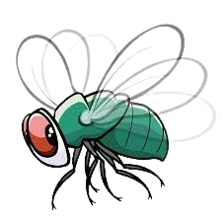

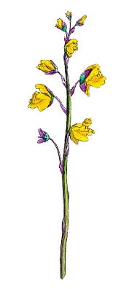
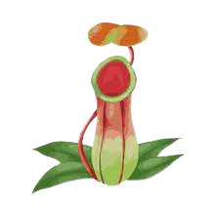
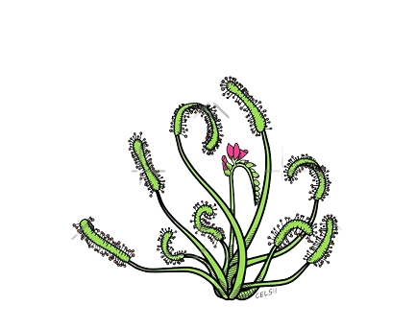


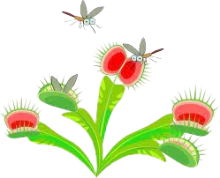
Once you’ve explored all the carnivorous plants, click on the frog to end your journey through the bog!
Click anywhere to begin!
Hello!
My name is Drosophila melanogaster but you can call me Mr. Fly! Let’s explore this bog full of carnivorous plants!
Click anywhere to continue
On our journey we’ll learn about each plants unique adaptations, traps and characteristics!
Click anywhere to continue
Click on each plant to learn about it and its role in the bog.
Click anywhere to continue

Slide 9
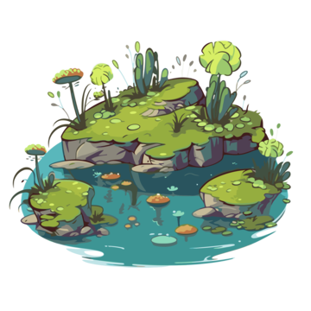
You shouldn't be here!
Go back to the bog!!!

Slide 10
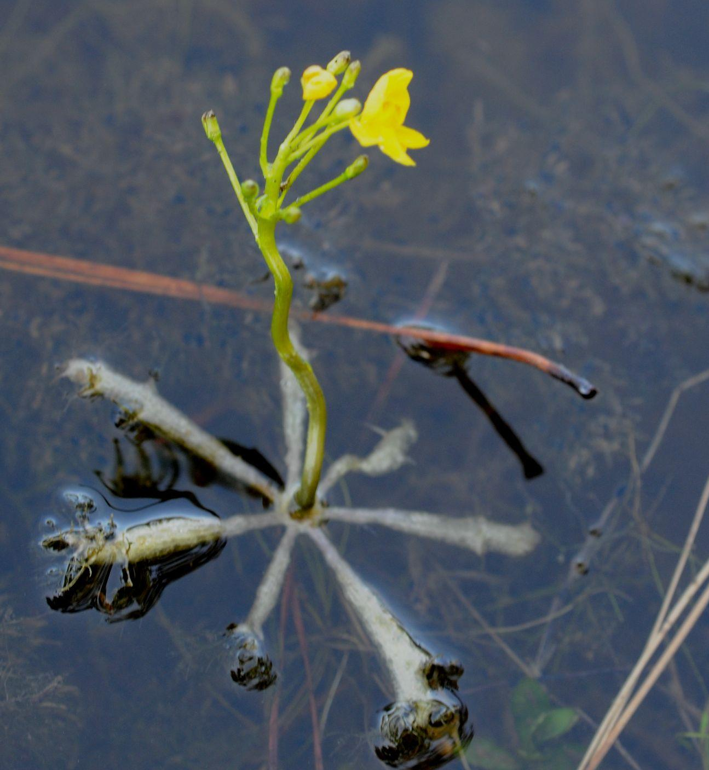

This is a Bladderwort!
Click anywhere to continue
These roots help the plant float on top of the water.
Click anywhere to continue
Let’s get a closer look at the roots and suction bladders.
Click the roots to zoom in

Slide 11
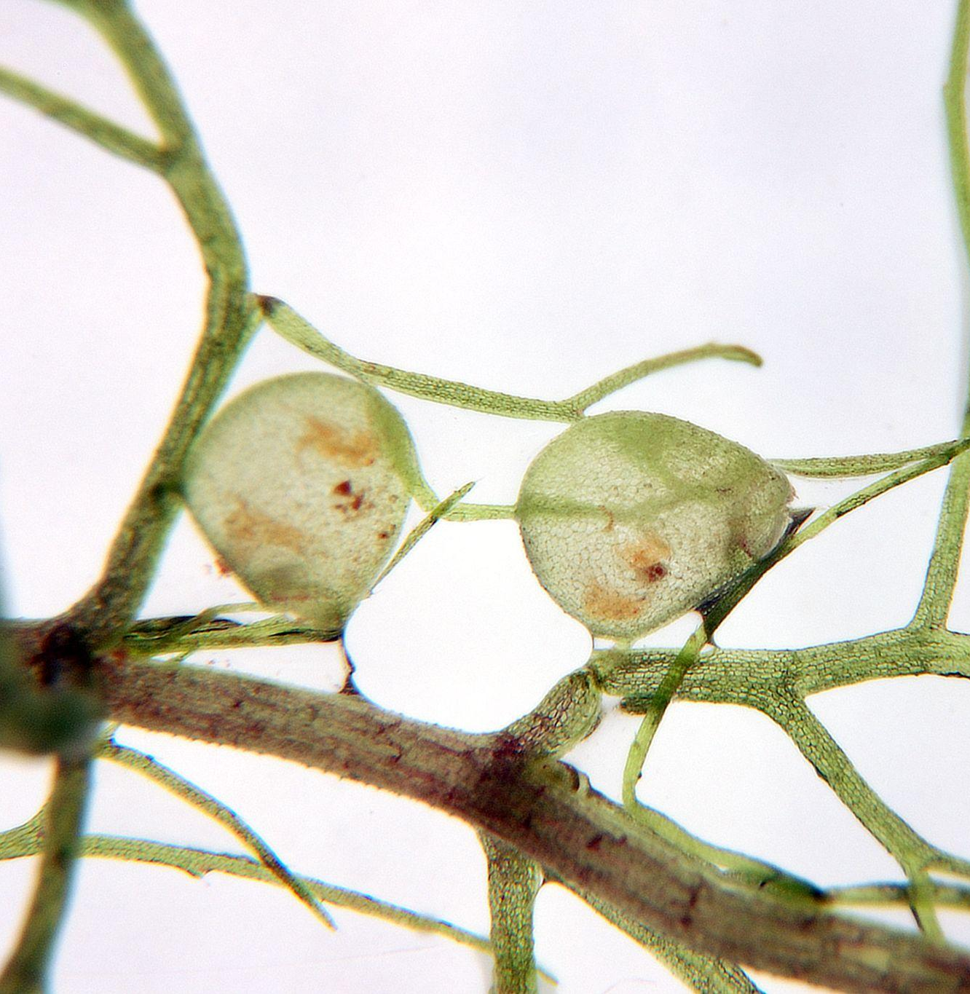
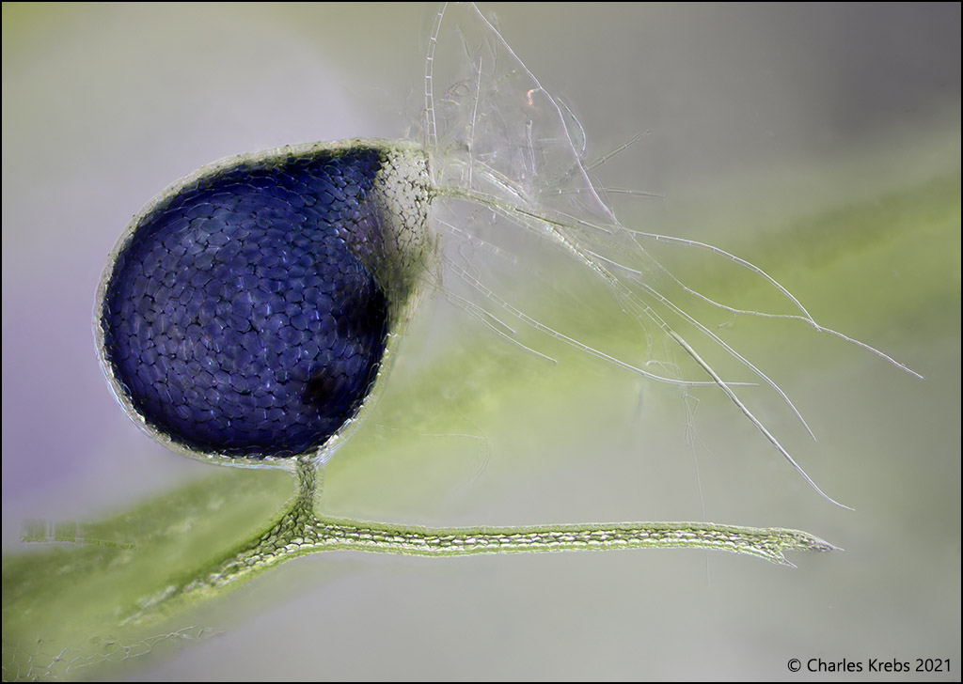
These roots contain smaller structures, called bladders, that suck in small insects!
Click anywhere to zoom in even more
When an insect triggers the hairs at the opening of the bladder, the bladder opens and sucks in the prey!
Click here to
return to The Bog
Michal Rubeš

Slide 12
You shouldn't be here!
Go back to the bog!!!

Slide 13
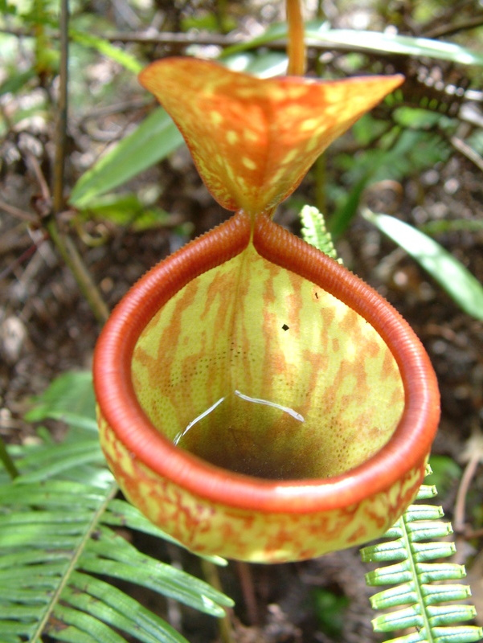
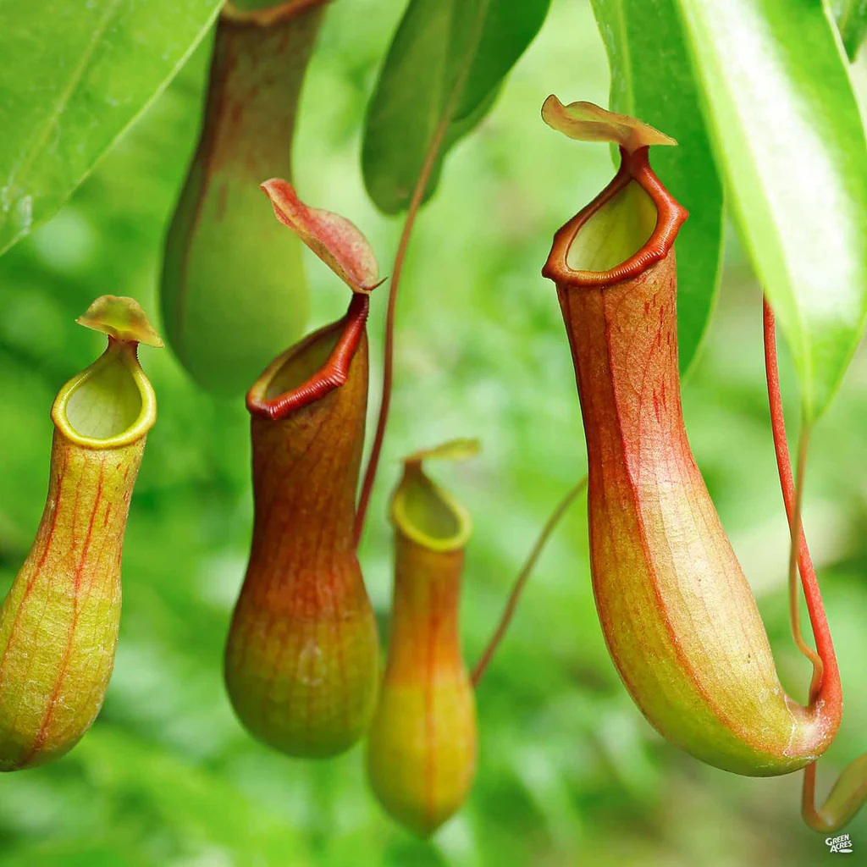
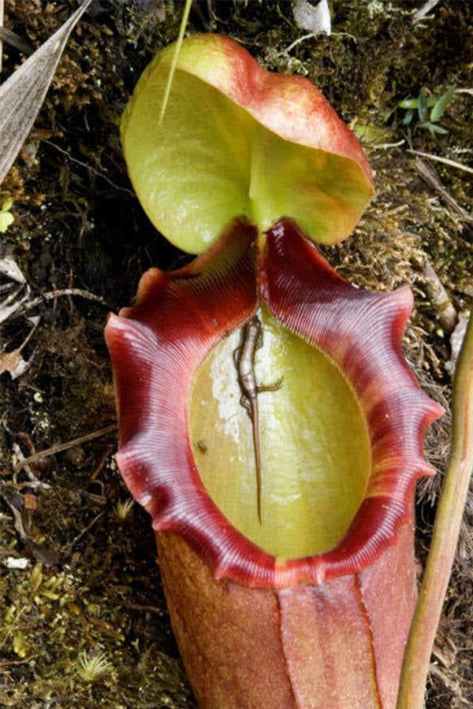
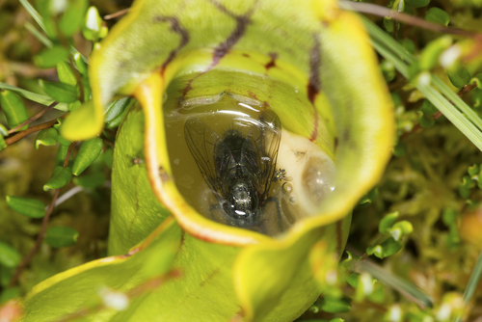
This is a Pitcher Plant!
Click anywhere to continue
What do you think
we’ll see inside?
Click through the photos to find out!
Click anywhere to continue
These pitcher plants have captured prey inside their pitcher-shaped traps.
Click anywhere to continue

Slide 14
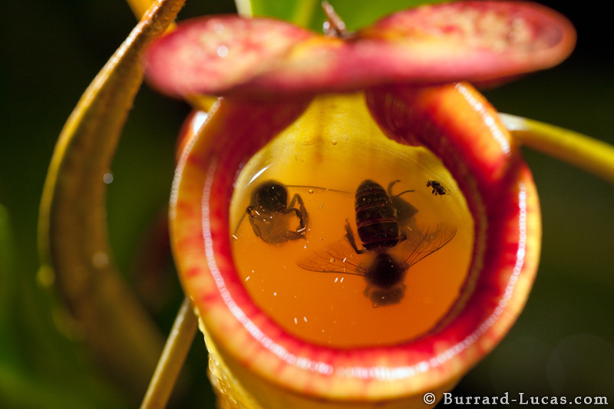
Pitcher plants fill with rain water to drown their prey, then little by little the insects or other small creatures are dissolved by enzymes released by the plant.
Click here to
return to The Bog

Slide 15
You shouldn't be here!
Go back to the bog!!!

